Slide 1
Python Function Tracing: Understanding Code Execution Step by Step

Slide 2
Welcome to Function Tracing
You will learn to trace Python functions step by step
Understand how variables change during execution
Master the art of debugging through systematic tracing
Opening Circle: Share one Python function you find challenging to understand
Today's learning target: Create accurate trace tables for any Python function

Slide 3
What is Function Tracing?
Function tracing tracks how variables change as code executes
You follow each line of code in order of execution
Record variable values at each step in a trace table
Think-Pair-Share: Discuss why tracing helps with debugging
Essential skill for understanding program flow and finding errors

Slide 4
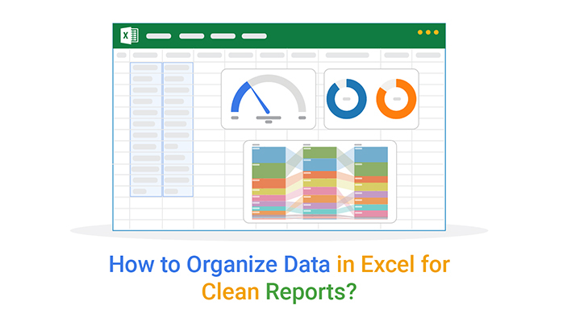
Basic Trace Table Structure
Create columns for: Line Number, Code Executed, Variables, Output
Record each step as the program runs
Track all variable assignments and changes
Note when functions are called or return values
Compass Points activity: Move to corners based on your tracing experience level
Notes:
Image from: https://chartexpo.com/blog/how-to-organize-data-in-excel

Slide 5
Simple Addition Function Trace
Function: def add_numbers(a, b): return a + b
Call: result = add_numbers(5, 3)
Line 1: a = 5, b = 3 (parameters assigned)
Line 2: return 5 + 3 = 8
Final: result = 8
Back-to-Back, Face-to-Face: Explain this trace to your partner

Slide 6
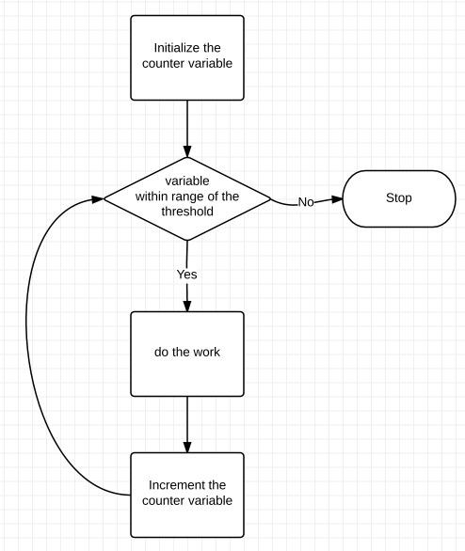
Loop Function Tracing Example
Function: def count_up(n): for i in range(n): print(i)
Call: count_up(3)
Iteration 1: i = 0, prints 0
Iteration 2: i = 1, prints 1
Iteration 3: i = 2, prints 2
Loop ends, function returns None
Notes:
Image from: https://knowthecode.io/labs/building-blocks-of-programming/episode-7

Slide 7
Conditional Function Trace
Function: def check_grade(score): if score >= 90: return "A"; else: return "B"
Call: grade = check_grade(85)
Line 1: score = 85 (parameter assigned)
Line 2: Check if 85 >= 90 (False)
Line 3: Execute else branch, return "B"
Final: grade = "B"
Reflection Question: How would the trace differ with score = 95?

Slide 8
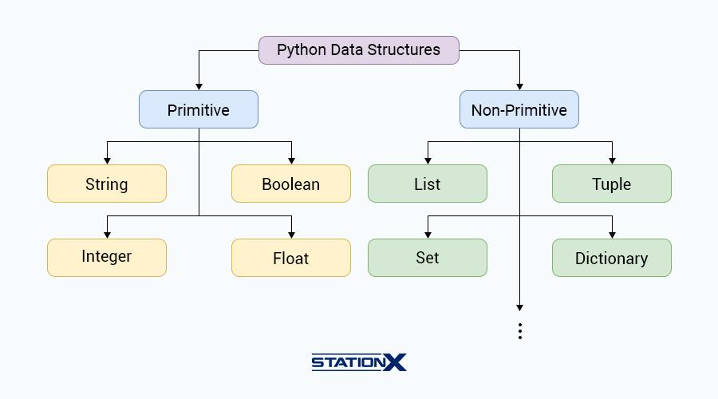
List Manipulation Function
Function: def double_list(nums): return [x * 2 for x in nums]
Call: result = double_list([1, 2, 3])
Step 1: nums = [1, 2, 3]
Step 2: Process x = 1, calculate 1 * 2 = 2
Step 3: Process x = 2, calculate 2 * 2 = 4
Step 4: Process x = 3, calculate 3 * 2 = 6
Final: result = [2, 4, 6]
Notes:
Image from: https://www.stationx.net/python-data-structures-cheat-sheet/

Slide 9
Recursive Function Tracing
Function: def factorial(n): if n <= 1: return 1; else: return n * factorial(n-1)
Call: factorial(3)
Call 1: n = 3, 3 > 1, return 3 * factorial(2)
Call 2: n = 2, 2 > 1, return 2 * factorial(1)
Call 3: n = 1, n <= 1, return 1
Unwind: 2 * 1 = 2, then 3 * 2 = 6
Think-Pair-Share: Discuss how the call stack works in recursion

Slide 10

Common Tracing Mistakes
Forgetting to update variable values after assignments
Not following the correct order of execution
Skipping function calls or returns
Misunderstanding loop iteration counts
Learning Target Check-in: Rate your confidence in avoiding these mistakes (1-5)
Practice prevents these common errors
Notes:
Image from: https://www.twinkl.com.cn/resource/t-i-026-computing-debugging-champion-poster

Slide 11
Your Turn: Practice Tracing
You will trace this function: def mystery(x, y): z = x + y; if z > 10: z = z - 5; return z * 2
Call: result = mystery(7, 6)
Work with your partner to create a complete trace table
Include all variable assignments and conditional checks
Exit Ticket: What was the final value of result?
Closing Circle: Share one insight about function tracing you gained today

